Slide 1
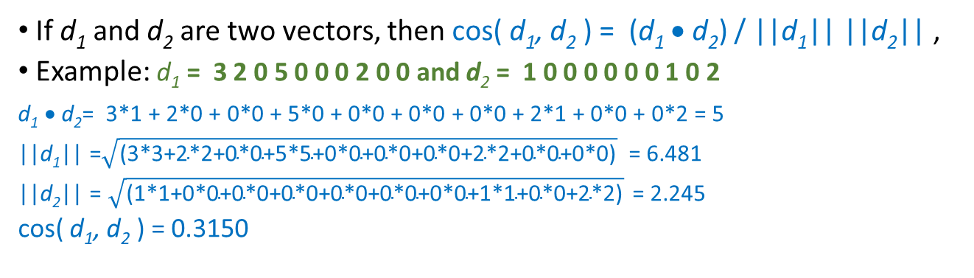
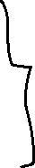
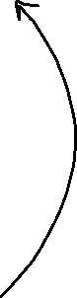
Jaccard similarity: JSim (C₁, C₂) = |C₁∩C₂| / |C₁∪C₂|
Cluster | Apple | Microsoft | Obama | Election
D1 | 10 (= 10/30 = 1/3) | 20 (= 20/30 = 2/3) | 0 | 0
D2 | 30 (= 30/90 = 1/3) | 60 (= 60/90 = 2/3) | 0 | 0
D2 | 0 | 0 | 10 (= 10/30 = 1/3) | 20 (= 20/30 = 2/3)
How do we measure the similarity of two vectors? How well are the two vectors aligned?
Documents D1, D2 are in the “same direction” while Document D3 is orthogonal to these two
cosine similarity : Sim(X,Y) = cos(X,Y)
If d₁ and d₂ are two vectors, then cos( d₁, d₂ ) = (d₁ • d₂) / ||d₁|| ||d₂|| ,
Example: d₁ = 3 2 0 5 0 0 0 2 0 0 and d₂ = 1 0 0 0 0 0 0 1 0 2
d₁ • d₂= 3*1 + 2*0 + 0*0 + 5*0 + 0*0 + 0*0 + 0*0 + 2*1 + 0*0 + 0*2 = 5
||d₁|| =$\sqrt{\text{(3∗3+2∗2+0∗0+5∗5+0∗0+0∗0+0∗0+2∗2+0∗0+0∗0)}}$ = 6.481
||d₂|| = $\sqrt{\text{(1∗1+0∗0+0∗0+0∗0+0∗0+0∗0+0∗0+1∗1+0∗0+2∗2)}}$ = 2.245
cos( d₁, d₂ ) = 0.3150
cos(D1,D2) = 1
cos(D1,D3) = cos(D2,D3) = 0

Slide 2
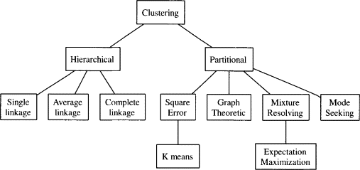
Clustering Algorithms

Slide 3
Hierarchical Clustering
Produces a set of nested clusters organized as a hierarchical tree
Can be visualized as a dendrogram - a tree like diagram that records the sequences of merges or splits
Can be of 2 types:-
Agglomerative clustering: Commonly referred to as AGNES (AGglomerative NESting) works in a bottom-up manner. That is, each observation is initially considered as a single-element cluster (leaf). At each step of the algorithm, the two clusters that are the most similar are combined into a new bigger cluster (nodes). This procedure is iterated until all points are a member of just one single big cluster (root).
Divisive hierarchical clustering: Commonly referred to as DIANA (DIvise ANAlysis) works in a top-down manner. DIANA begins with the root, in which all observations are included in a single cluster. At each step of the algorithm, the current cluster is split into two clusters that are considered most heterogeneous. The process is iterated until all observations are in their own cluster.
Limitations:
Once a decision is made to combine two clusters, it cannot be undone
Different schemes have problems with one or more of the following:
Sensitivity to noise and outliers
Difficulty in handling different sized clusters and convex shapes
Breaking large clusters

Slide 4
How to Define Inter-Cluster Distance
Single-Linkage: distance of the closest pair of data objects belonging to different clusters. The distance between two clusters is represented. Sensitive to noise and outliers in the form chaining.
Complete-Linkage: distance of the farthest pair of data objects belonging to different clusters. Less susceptible to noise and outliers. Points may be much closer to some points in neighbouring clusters that its own clusters. Results in breaking the large clusters
Average-Linkage: distance between two clusters is represented by the average distance of all pairs of data objects belonging to different clusters.

Slide 5
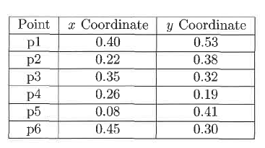
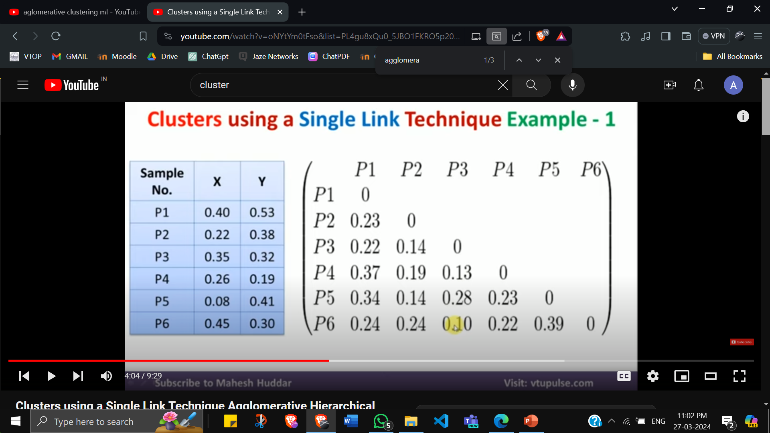
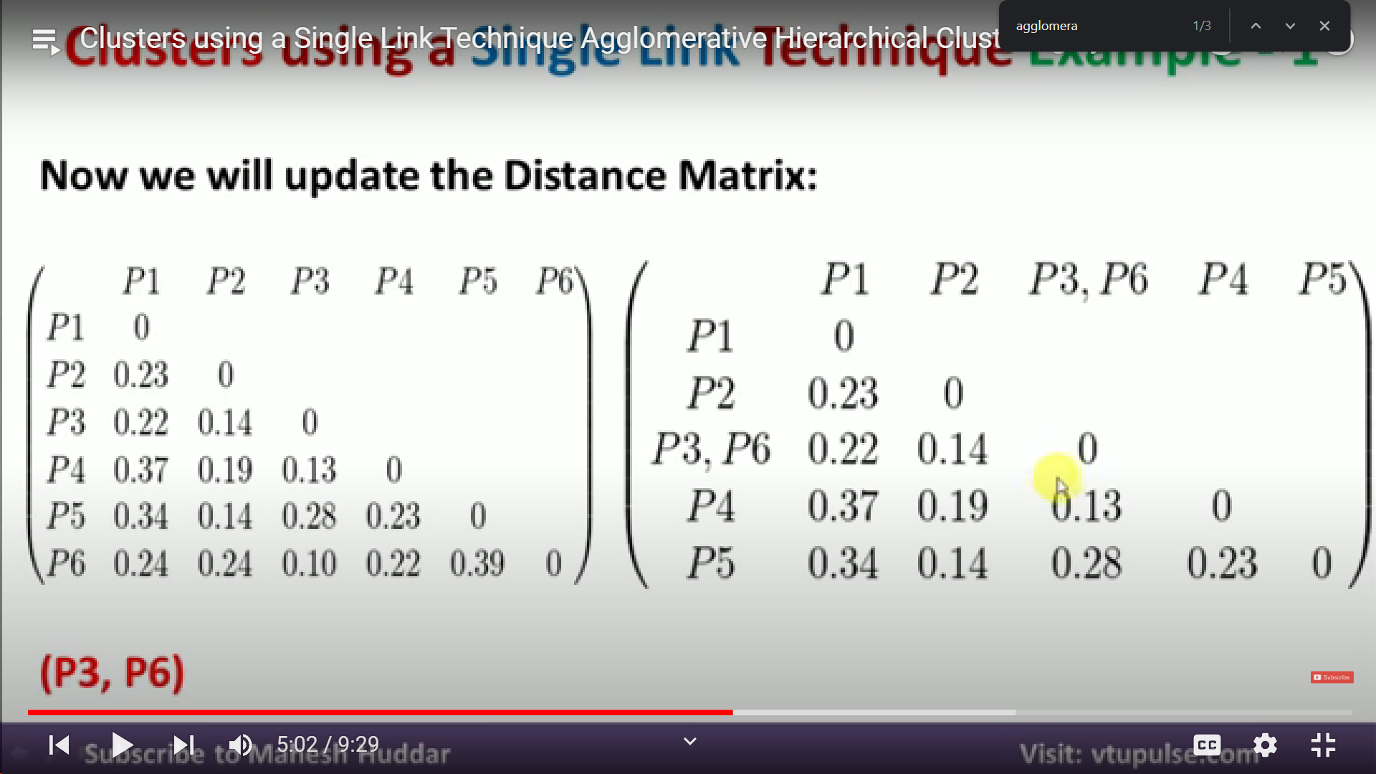

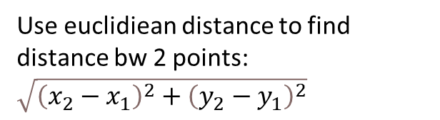
Agglomerate Clustering using Single Link
Distance Matrix
Use euclidiean distance to find distance bw 2 points: $\sqrt{{\left(x_{2}−x_{1}\right)}^{2}+{\left(y_{2}−y_{1}\right)}^{2}}$
Since min element 0.10 is present in row P6 and column P3, we delete P6 and form new cluster (P3,P6)

Slide 6
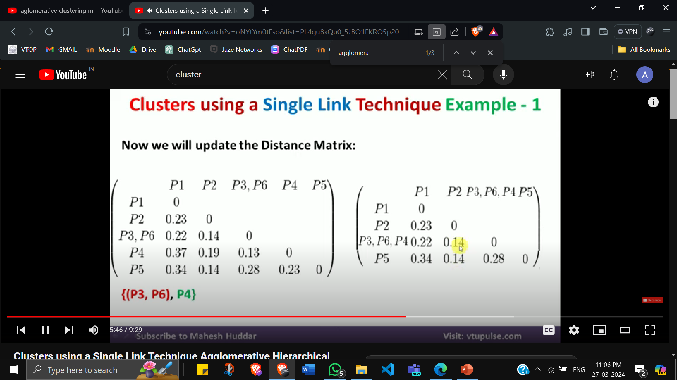
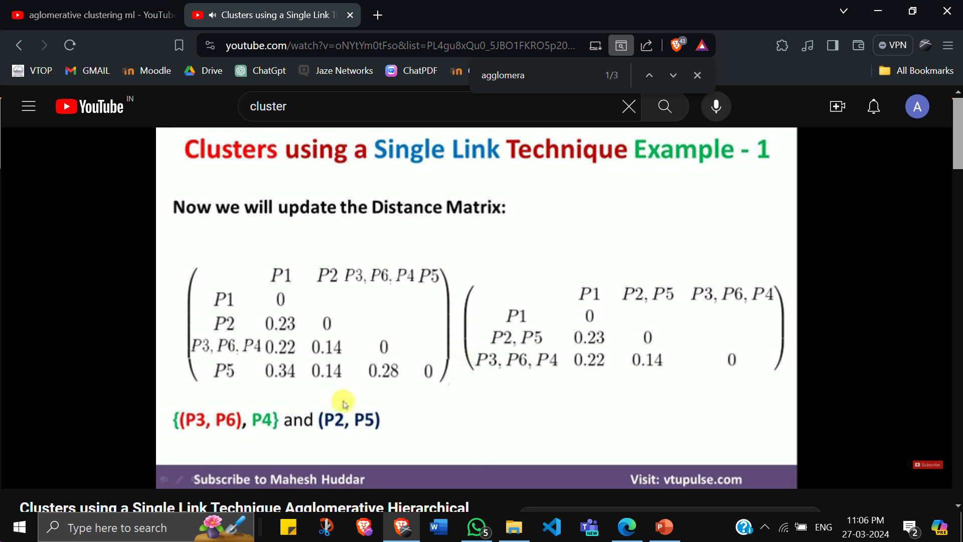
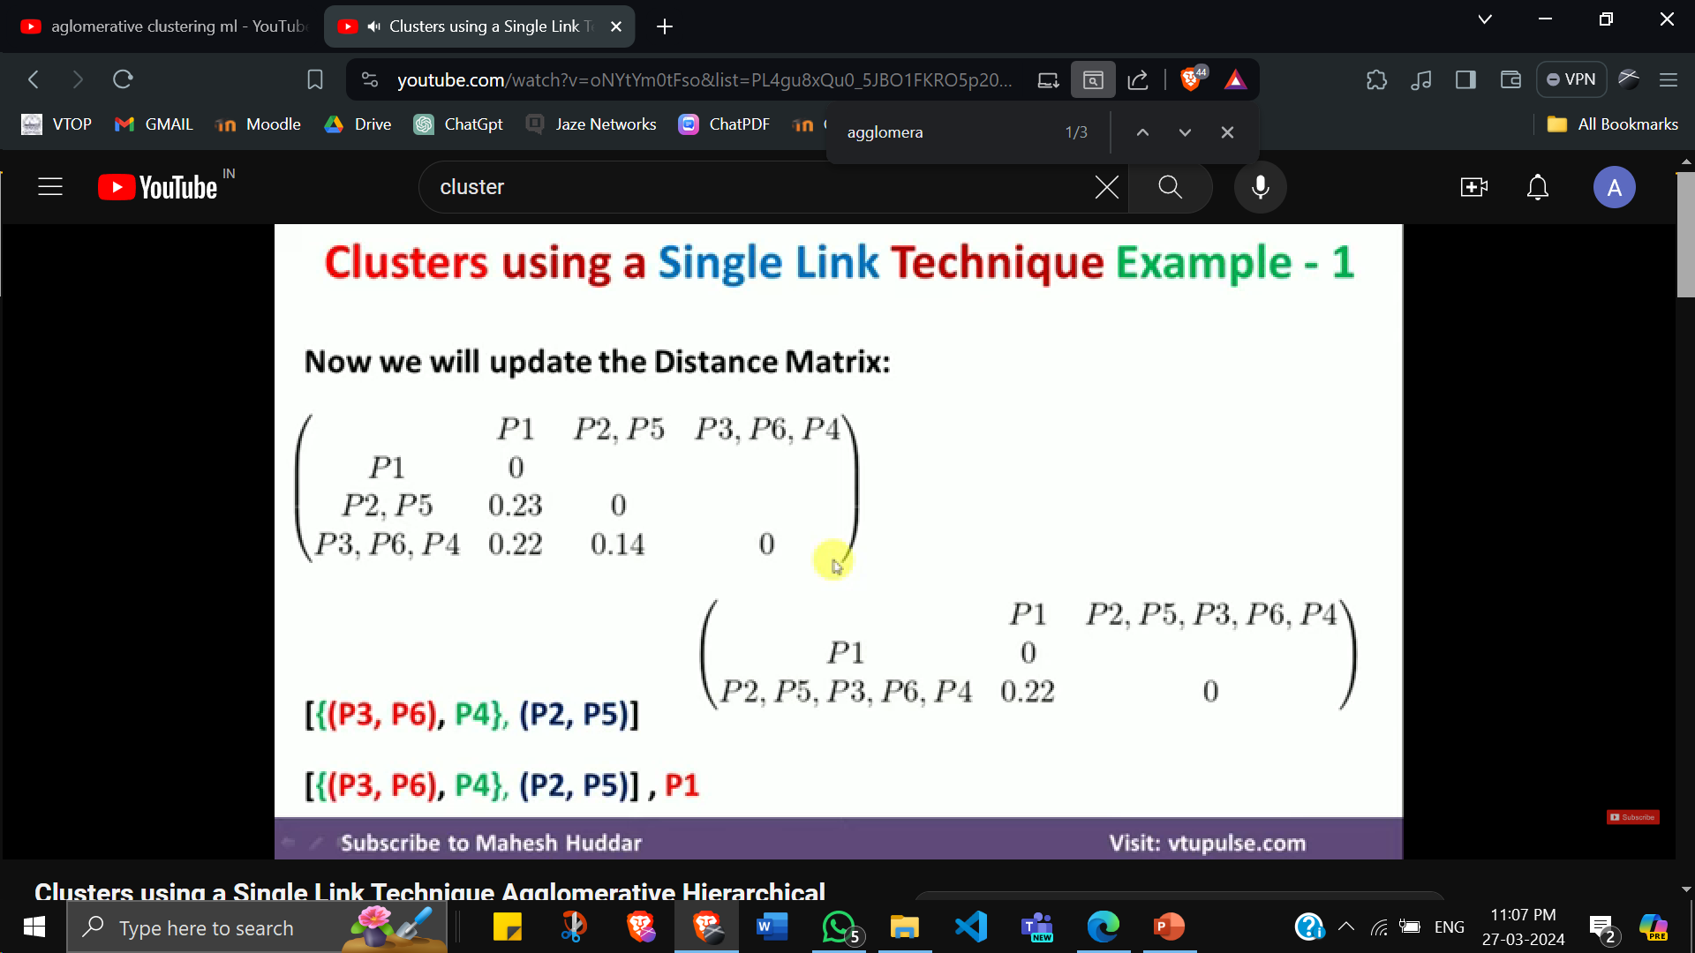
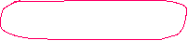
Since min element 0.13 is present in row P4 and column (P3,P6) we delete P4 and form new cluster (P3,P6,P4)
Since min element 0.14 is present in row P5 and column P2, we delete P5 and form new cluster (P2,P5)
Since min element 0.14 again is present in row (P3,P6,P4) and column (P2,P5), we delete (P3,P6,P4) and form new cluster (P2,P5, P3,P6,P4)

Slide 7
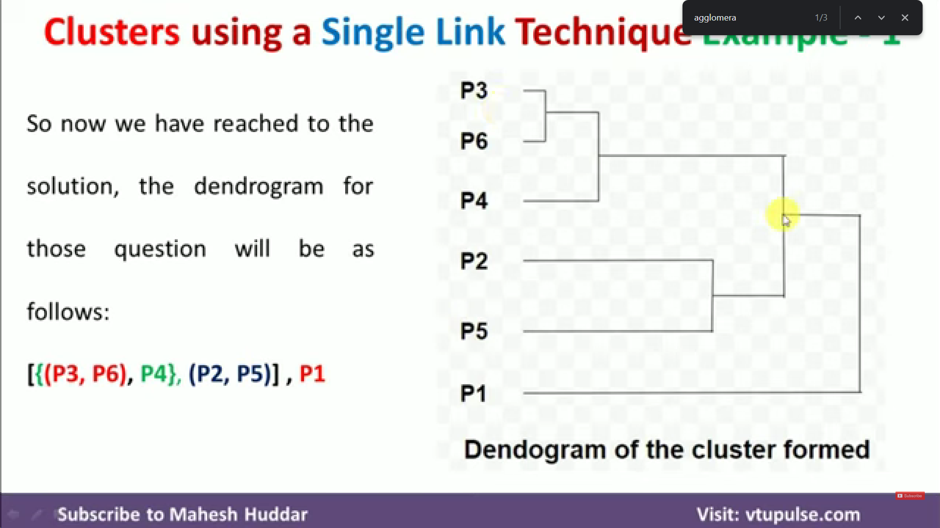

Slide 8
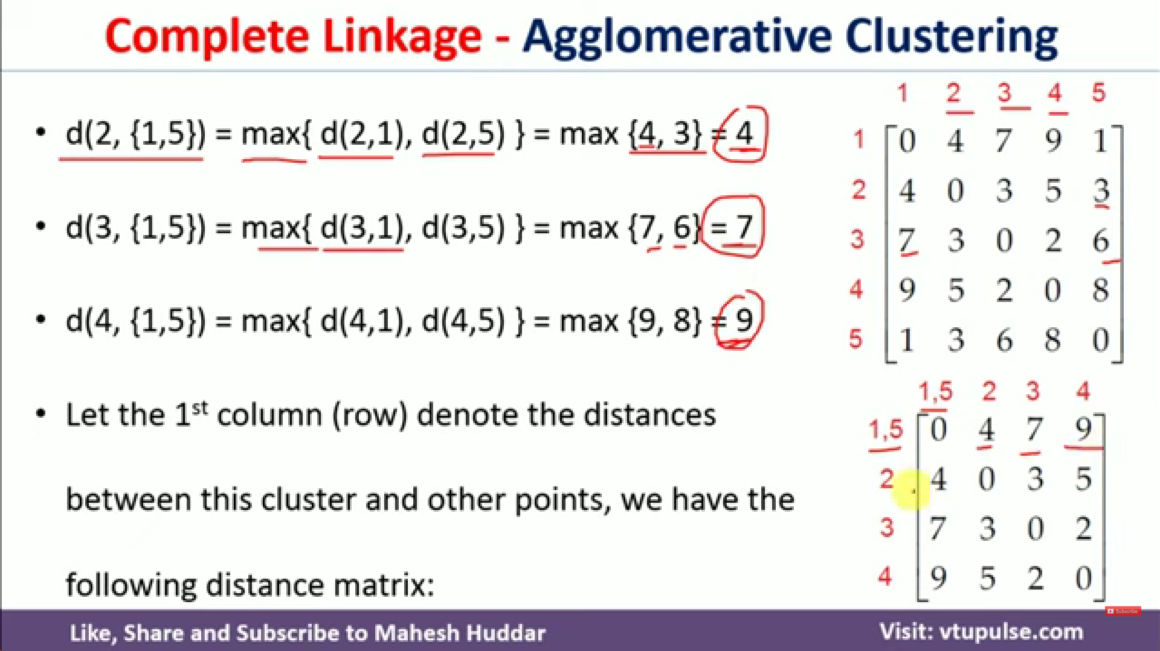

Agglomerate Clustering using Complete Link
Same as single link but here after deleting row with min element, when we proceed to merging step, we place the max element from the 2 rows into the final merged row except columns with 0.
Row 5 column 1 has min element 1, so delete row 5 and place max element of row 1 and 5 in new row(cluster) (1,5)
https://youtu.be/Ufzq9oLhzX0?si=ycT8emr860azrxGr

Slide 9
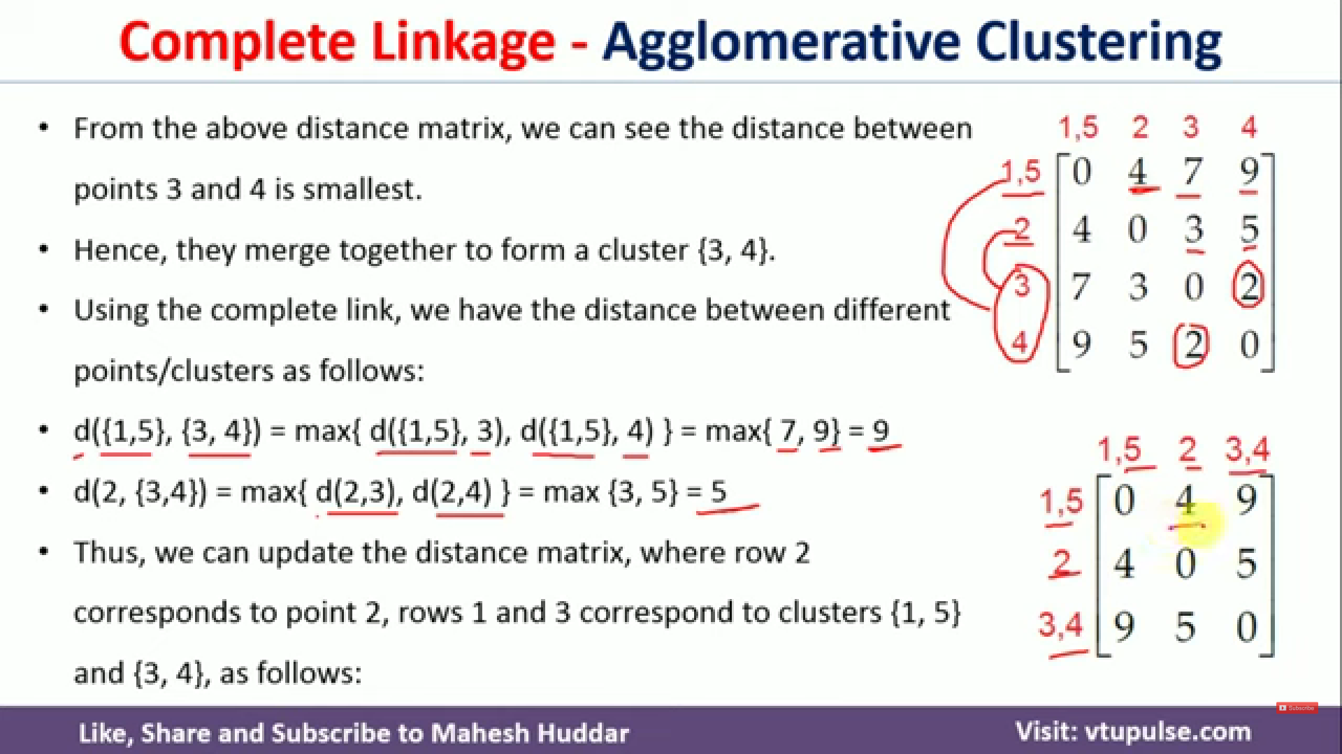
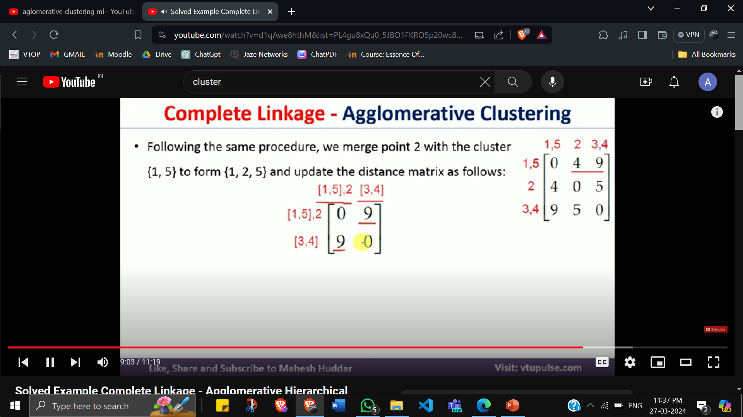
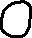
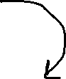

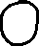
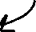
Remember to update column weights too

Slide 10
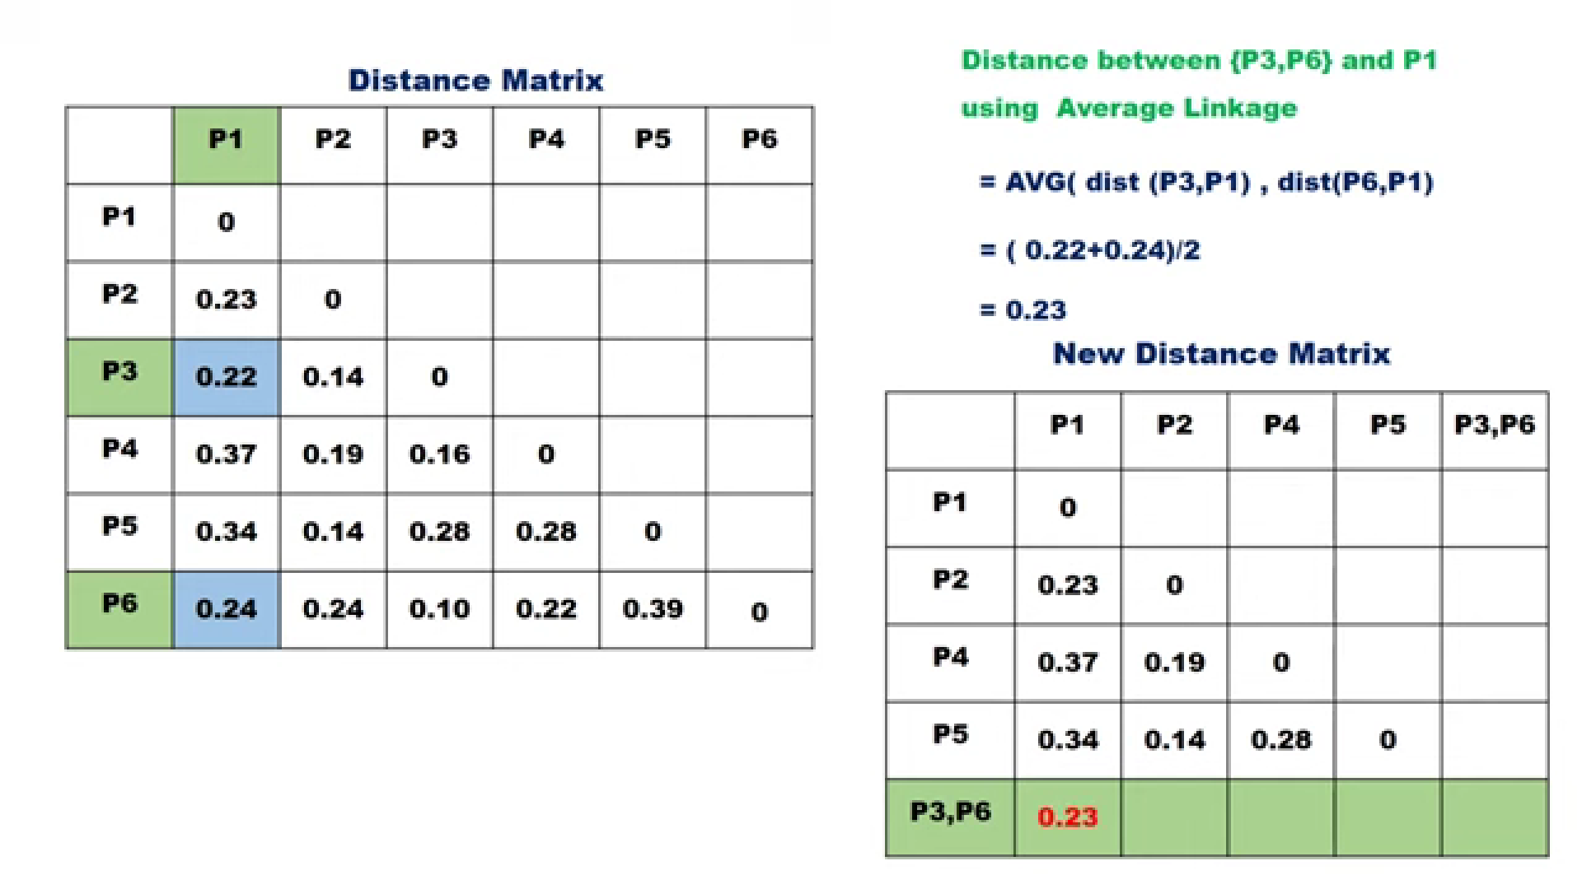
Average Linkage

Slide 11
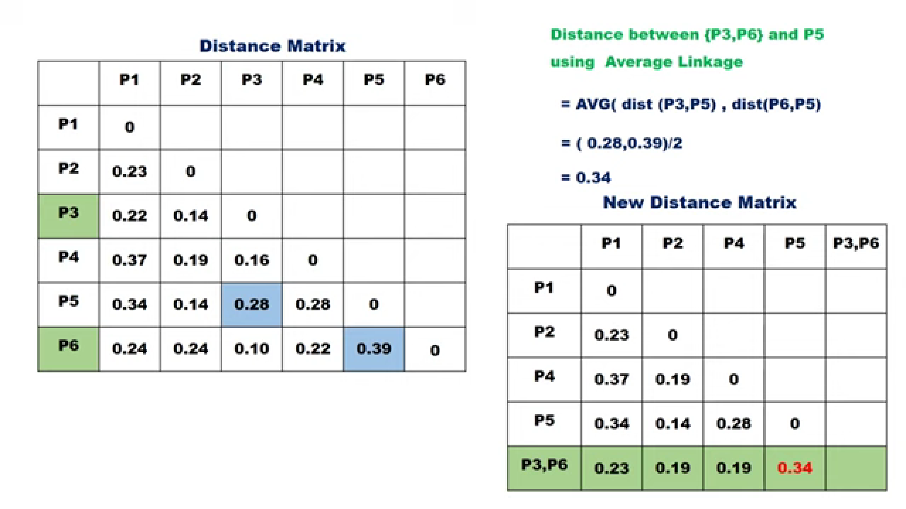

Slide 12
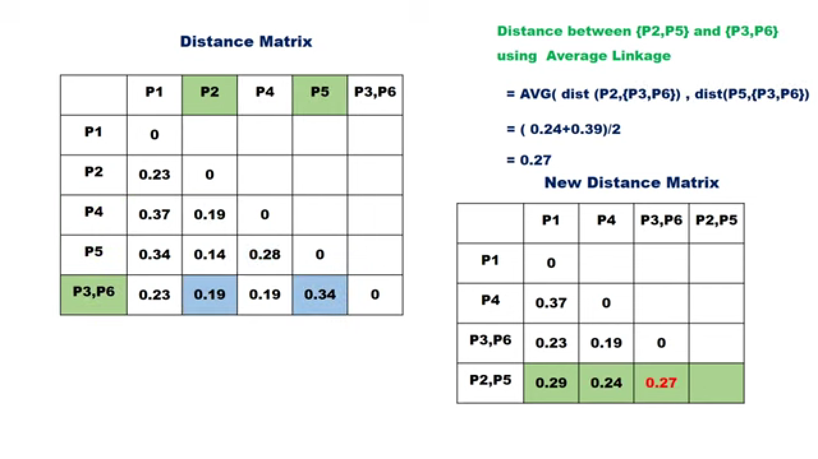

Slide 13
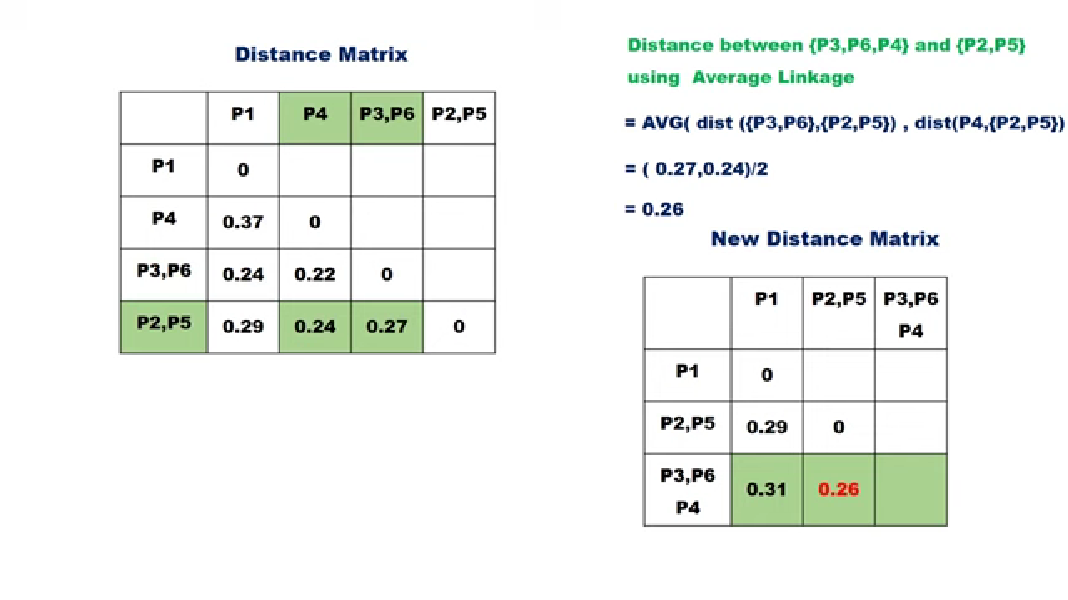

Slide 14
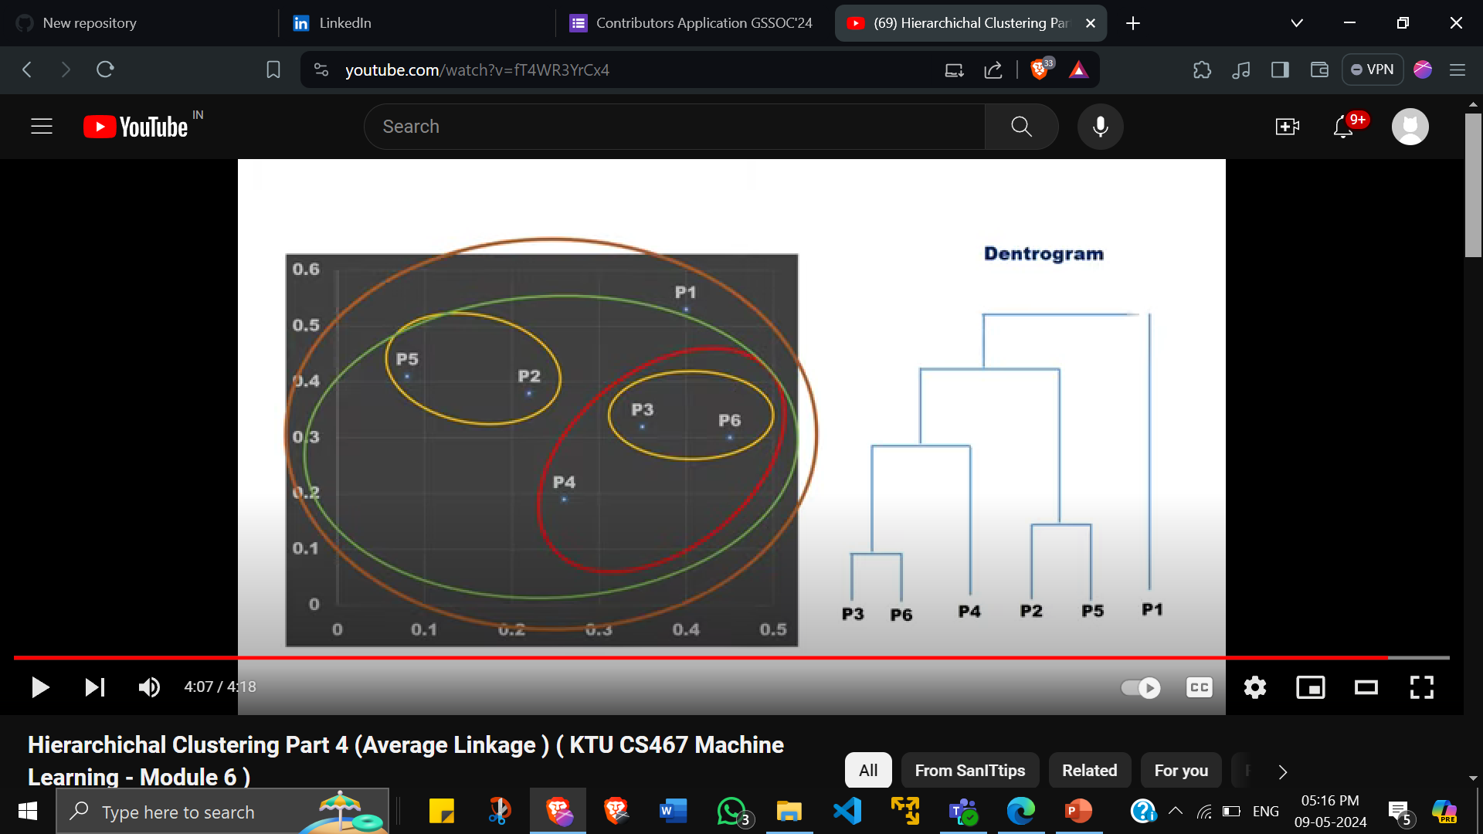
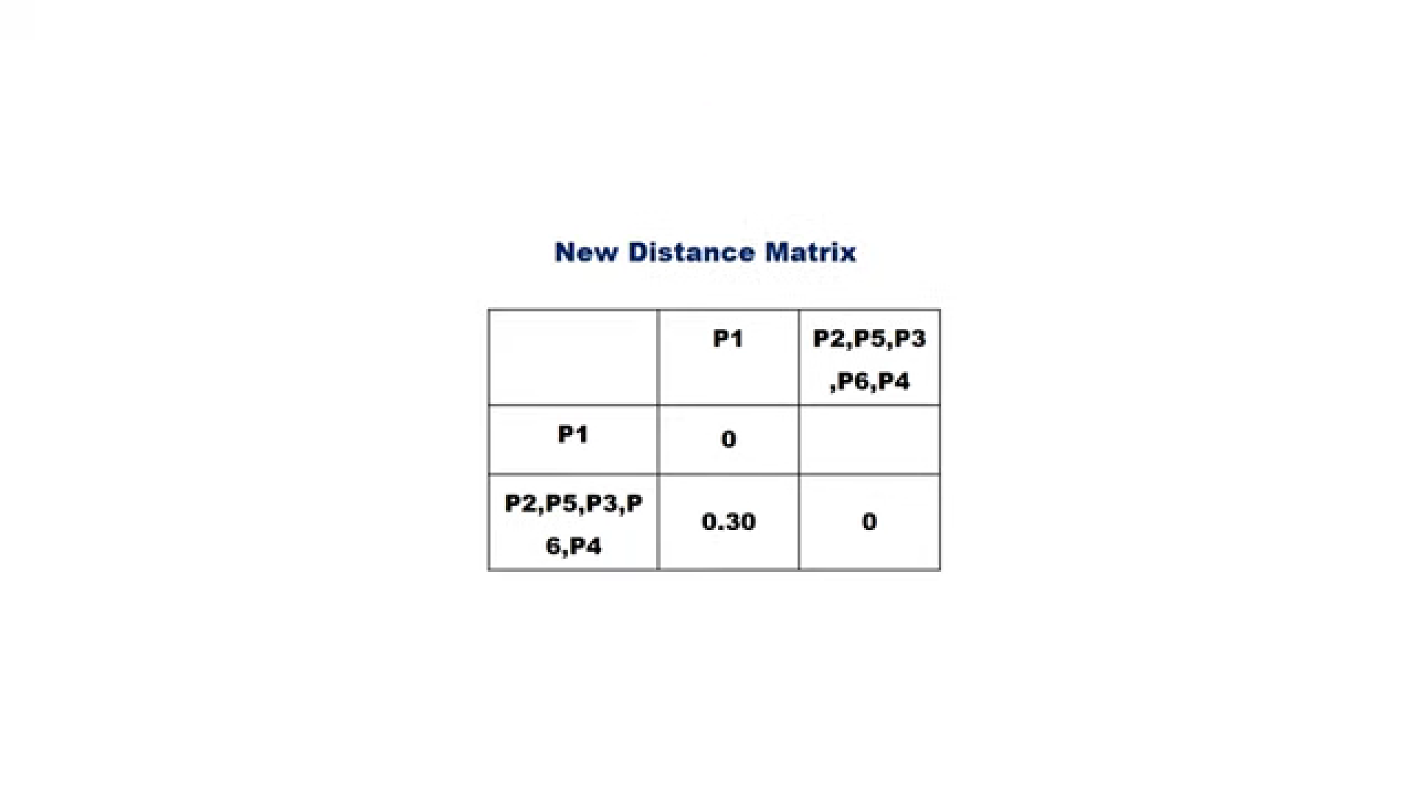

Slide 15
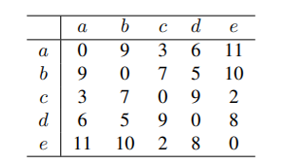
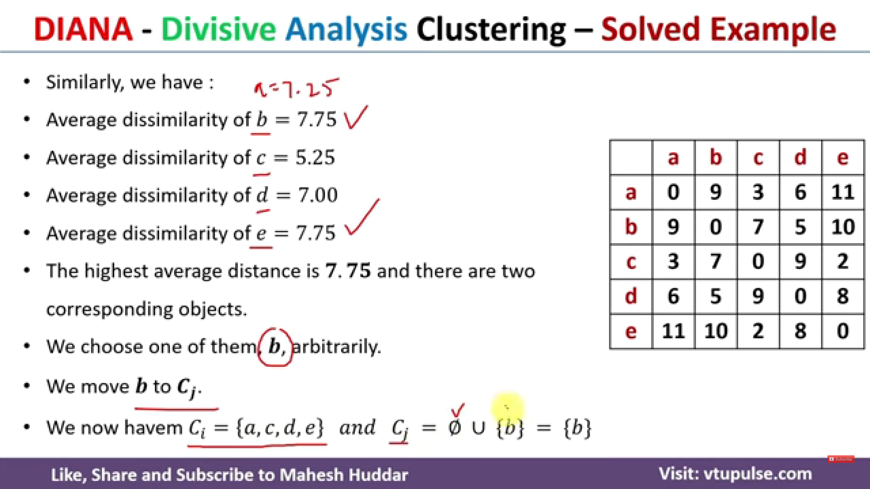
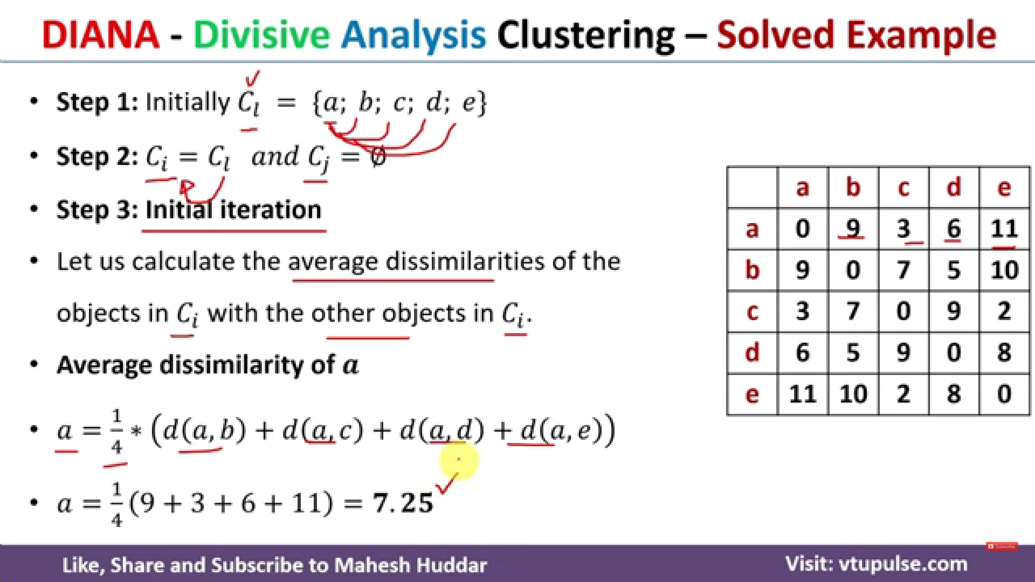
DIANA - Example

Slide 16
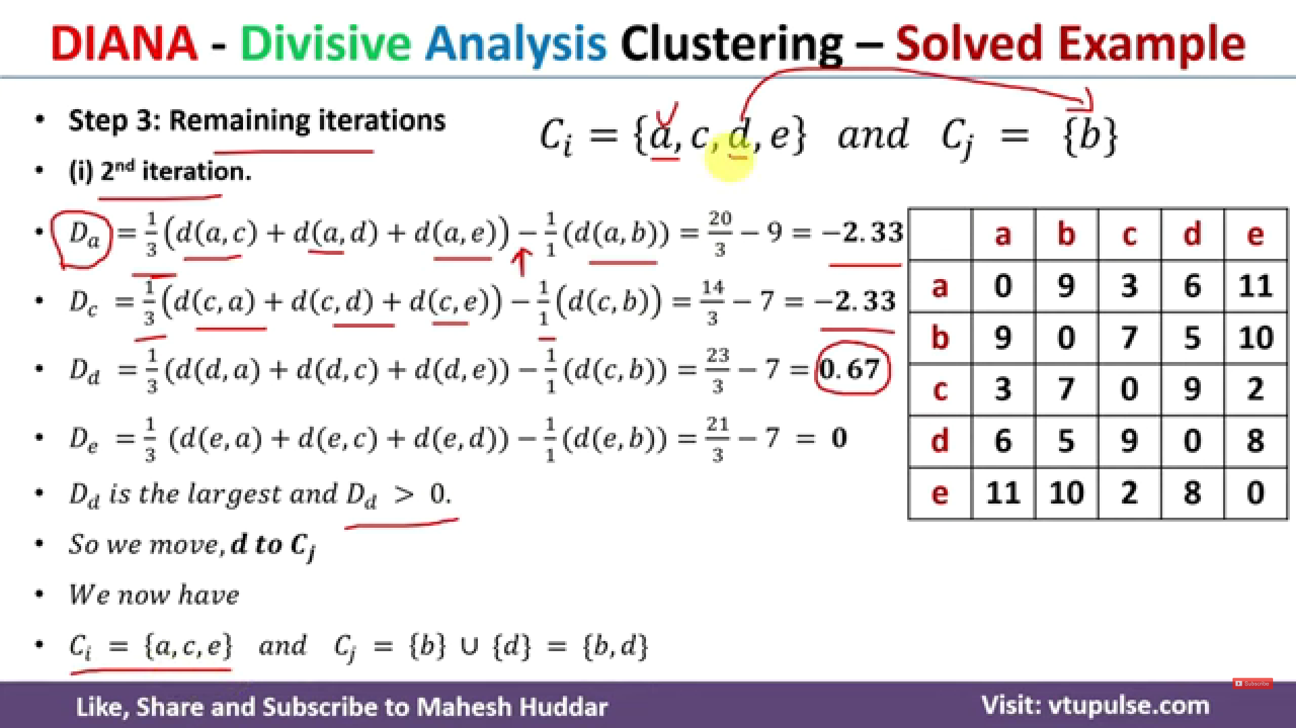

Slide 17
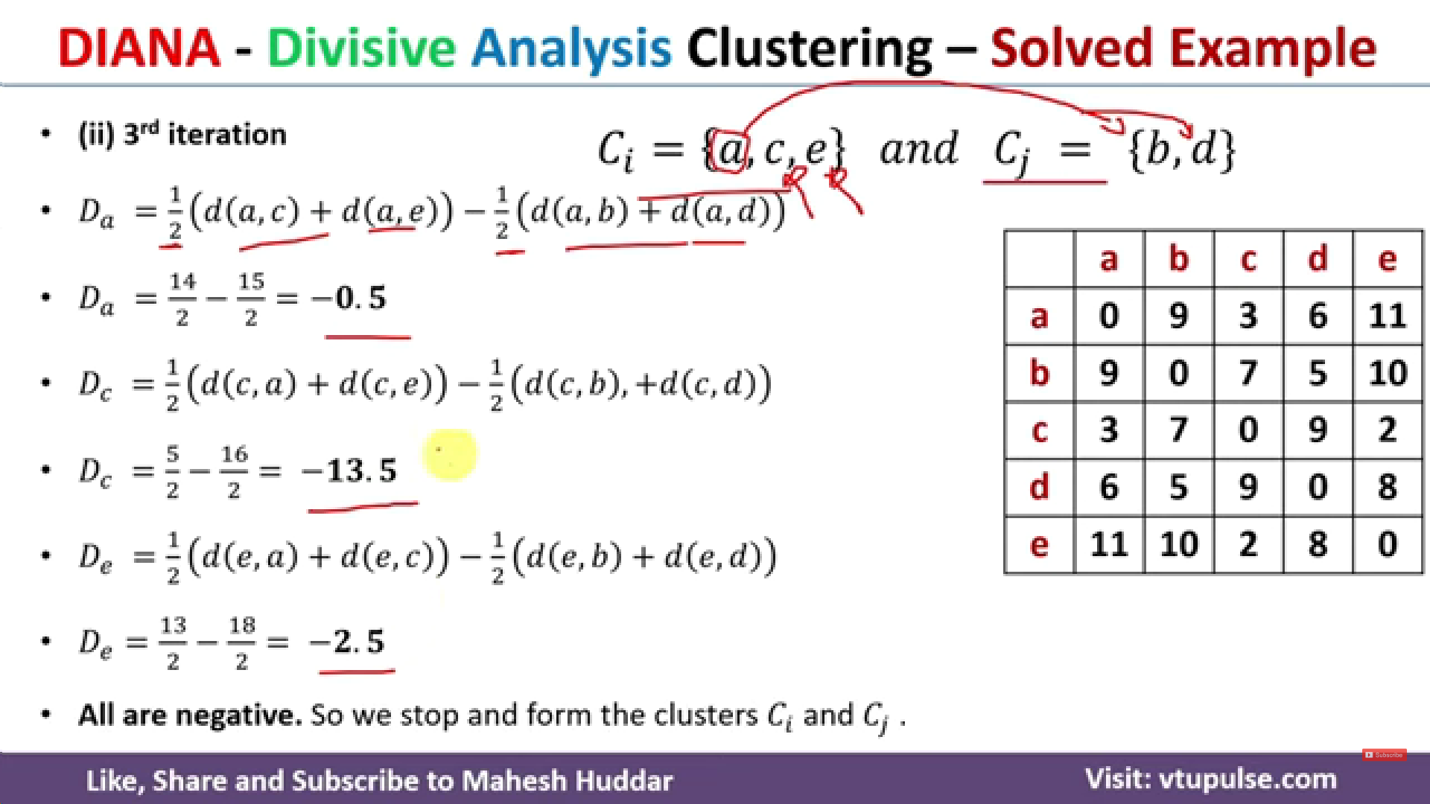

Slide 18
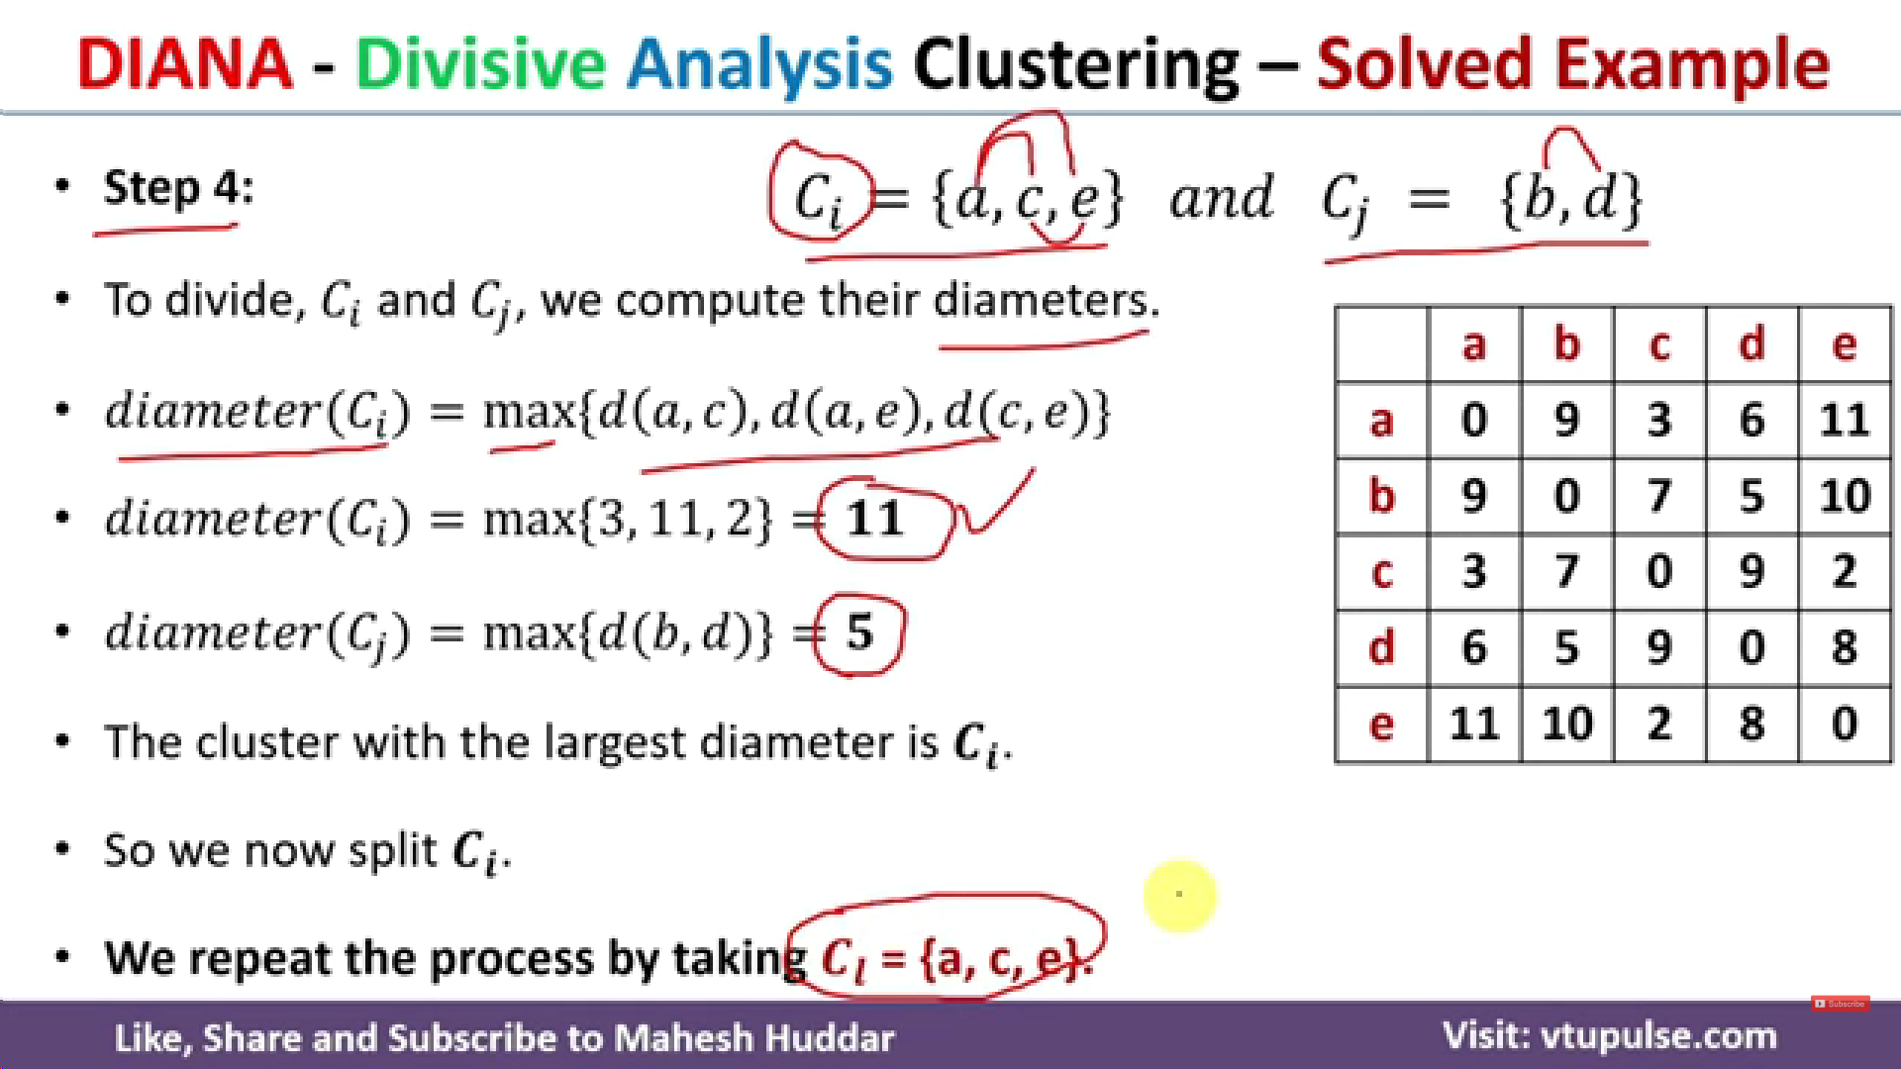

Slide 19
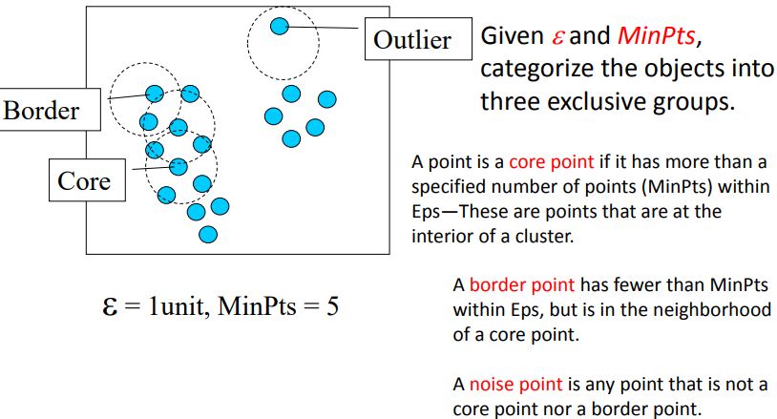
Density-Based Clustering Methods
Time Complexity: O(n²)—for each point it has to be determined if it is a core point (n is the number of objects to be clustered)
Space Complexity: O(n)
Good: can detect arbitrary shapes, not very sensitive to noise, supports outlier detection, beside K-means the second most used clustering algorithm.
Bad: does not work well in high-dimensional datasets, parameter selection is tricky, has problems of identifying clusters of varying densities (→SSN algorithm), density estimation is kind of simplistic (→does not create a real density function, but rather a graph of density-connected points)

Slide 20
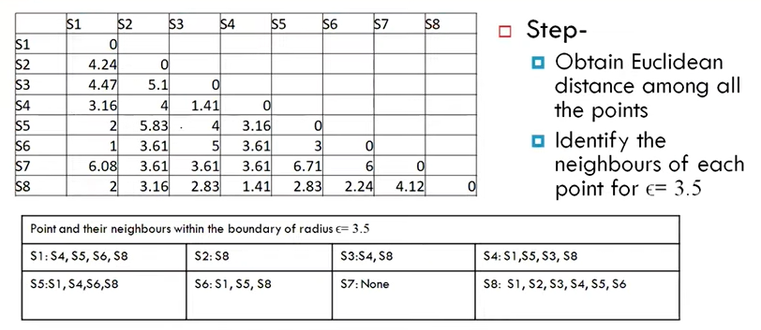
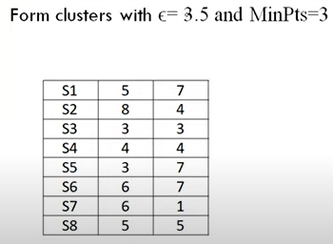
Example
Compute distance matrix and Compute Epsilon Neighborhood
For each column (say S3), select values < e=3.5 (here it is S4=1.41 and S8=2.83)

Slide 21
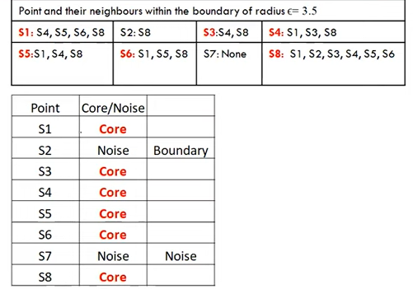
Now count the no. of total nodes in each group (say in S3, we have S3,S4,S8) = 3 nodes which is greater than equal to minpoint = 3 so categorize it as Core. If total count <= 3, categorize it as Noise
Next check if each node repeats in any other cluster
Say S1 repeats in S4, S5,S6,S8 -> label it as boundary; convert noise to boundary
Say S7 does not repeat in any cluster -> label it as not boundary

Slide 22
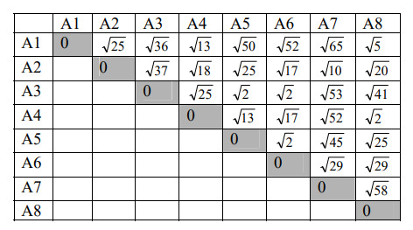
DBSCAN Exercise (2)
Consider the following 8 examples: A1=(2,10), A2=(2,5), A3=(8,4), A4=(5,8), A5=(7,5), A6=(6,4), A7=(1,2), A8=(4,9).
If Epsilon is 2 and minpoint is 2, identify the core points, noise points and border points. What are the clusters that DBScan would discover?
N2 Neighborhood with Epsilon<=2
N2(A1)={};
N2(A2)={};
N2(A3)={A5, A6};
N2(A4)={A8};
N2(A5)={A3, A6};
N2(A6)={A3, A5};
N2(A7)={};
N2(A8)={A4}
Core points : A6, A5, A3, A4 , A8
Outliers : A1, A2, and A7
Two clusters C1={A4, A8} and C2={A3, A5, A6}

